Slide 1



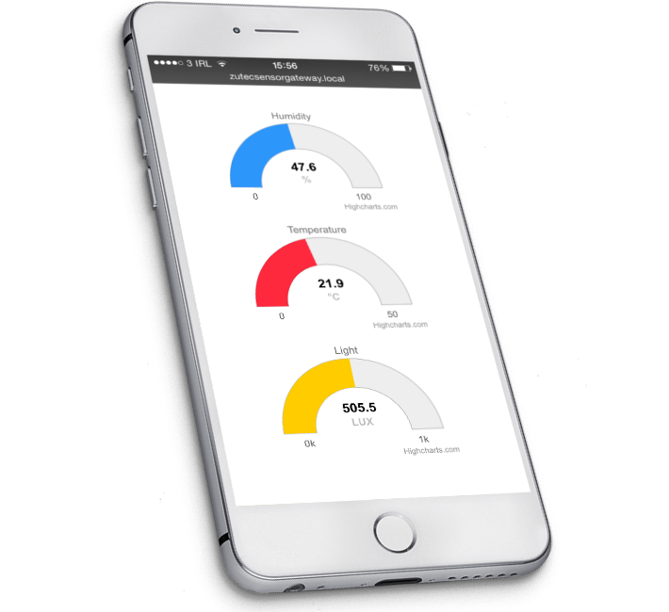


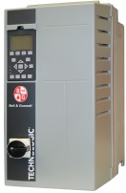





Device
Gateway
xCloud
RS-485
⬥
◆
❖

Xtag_{M}
❖
◆
Xtag_{B2}
Xtag
RS-485
Level | Feature | Interface | Note
 | Bearing Vibration and Temperature | Embedded sensors BT to device | Xtag base unit + simple web page server for PoC
 | Pump pressure and VFD data IO | External 4-20mA sensors (2), RS-485 | Optional connect VFD to GW in 3. Note that Xtag may be able to process VFD data to derive performance.
 | Gateway (GW) for local analytics and xCloud connection | Wi-Fi or BT to Xtag Cellular to xCloud | Provided as pass-thru GW with no local analytics in PoC
 | Optional test of Motor Temperature, Vibration and Flux | Embedded sensors BT to base Xtag or to GW | Xtag remote sensor not envisioned in commercial spec
◆
❖
⬥
*(opt)


